Slide 1
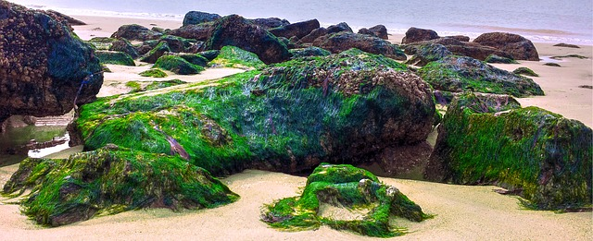
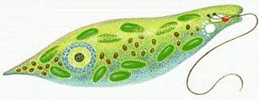
CHAPTER 2
BIOLOGICAL CLASSIFICATION
Class :- XI
Subject :- BIOLOGY

Slide 2
Biological classification
The process of grouping living organisms into convenient categories based on simple characters is known as Biological classification.
Two kingdom classification.
Plants. (autotrophs, cell wall, do not move)
Animals (heterotrophus, no cell wall, can move)
Linnaeus - plantae & Animalia
Later found two kingdom classification was not sufficient because in that
1. Prokaryotes & Eukaryotes were grouped together.
2. Heterotrophs & Autotrophs were together.
3. No difference between unicellular and multicellular
4. Simple organisms were placed along with higher organism.

Slide 3
Five kingdom classification. (R.H Whittaker 1959) Main criteria for classification:
Complexity of cell structure (prokaryotes/ eukaryote )
Body organization (unicellular/ multicellular)
Mode of nutrition (autotrophic / heterotrophic / holozoic)
Life style ( producers / consumers / decomposers)
Phylogenic relationships (revolutionary history)
Five kingdoms are
1. Kingdom Monera (bacteria ) – prokaryotic unicellular
2. Kingdom Protista ( amoeba ) – eukaryotic unicellular
3. Kingdom Fungi - multicellular eukaryotic
4. Kingdom Plantae - multicellular eukaryotic
5. Kingdom Animalia – multicellular eukaryotic

Slide 4
Kingdom - Monera (eg. Bacteria )
Habitats- omnipresent
Grouped in to 4 groups based on their shape.
1. Cocus (spherical) 2. Bacillus (rod) 3. Vibrio (comma) 4. Spirillum (spiral)
Mode of nutrition – autotrophs and heterotrophs.
Kingdom Monera – includes;
1. Archaebacteria
2. Eubacteria (Cyanobacteria, Chemosynthetic and Heterotrophic)
3. Mycoplasma

Slide 5
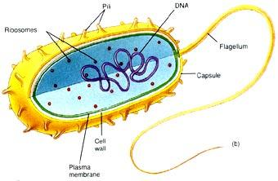
Archaebacteria – Harsh habitats
Halophiles (saline)
Thermoacidophiles (hot spring),
Methanogens (gut of ruminants)
Eubacteria – True bacteria - Rigid cell wall - Motile flagellum
Autotrophic bacteria - Cyanobacteria (BGA) have chlorophyll a unicellular, colonial/ filamentous.
Marine /terrestrial habitat/ gelatinous sheath
Form blooms - can fix nitrogen in heterocysts. Eg. Nostoc, Anabaena.

Slide 6
Chemosynthetic bacteria – Oxidise nitrates , nitrites and ammonia release energy (ATP) help in Recycling of nutrients ( eg. Pseudomonas, nitrobacter )
Heterotrophic bacteria – Decomposers – making curd from milk, antibiotics, nitrogen fixing (Rhizobium ) some are pathogenic ( cause diseases ) cholera, T.B, diarrhea.
Reproduction by binary fission, spore / sexual reproduction.
Mycoplasma. No cell wall – smallest living cell.
Anaerobic – pathogenic in animals and plants.

Slide 7
Kingdom -Protista
Unicellular – Eukaryotic – aquatic
Flagella / cilia - Reproduce sexually / asexually
Chrysophyta :
Planktons diatoms and golden algae ( desmids )
Fresh water/ marine
Microscopic – photosynthetic
In diatoms , cell wall is indestructible (silica )form diatomaceous earth, its being gritty used for polishing, filtration of oil and syrups.
Chief producers in oceans.

Slide 8
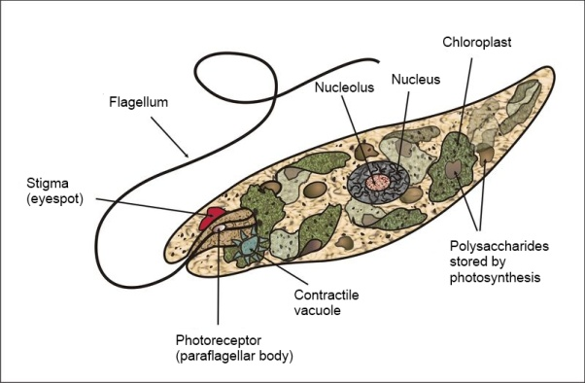
Dinoflagellates. Marine photosynthetic, yellow, green, blue or red pigments - Cell wall is cellulosic – have 2 flagella - Red dionflagellate (Gonyaulax ) forms red tides and toxins are released.
Euglenoid eg. Euglena
Fresh water – stagnant water – no cell wall but protein rich layer is present, called pellicle.
Pellicle is flexible with flagella – they are Myxotrophic, because Photosynthetic (in light)
Heterotrophs (when no light).
Myxotrophs – Mixture of both autotrophs and heterotrophs

Slide 9
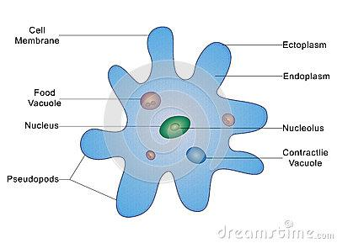
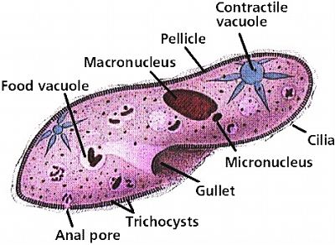
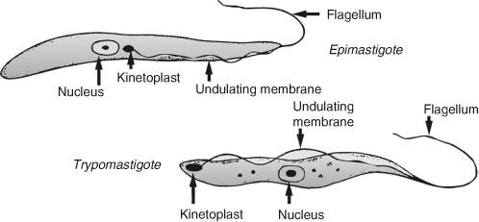
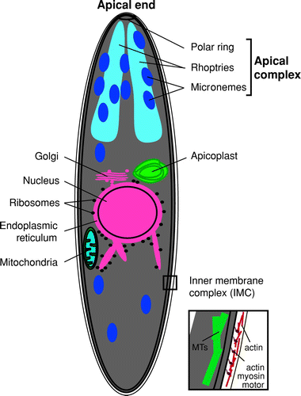
Protozoans – Heterotrophs – predators/ parasites
There are 4 major groups;
Amoeboid protozoans. Fresh water, sea and moist soil -pseudopodia – marine forms have silica shells . Entamoeba (parasite) cause Amoebic dysentery
Flagellated protozoans - free living / parasites have flagella – parasites cause diseases – Sleeping sickness (Trypanoroma) is a parasite of flagellated protozoans.
Ciliated protozoans – aquatic cilia, cavity gullet eg. Paramoecium.
Sporozoans – Spore stage in their life cycle. Plasmodium causes malarial fever.

Slide 10
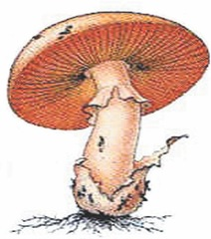
Kingdom - Fungi
Multicellular – eukaryotic – heterotrophic - cosmopolitan - grow in warm and humid places.
Fungi are filamentous with long, slender thread like Hyphae and the net work of hyphae is known as Mycelium – They can be septate or non septate (aseptate)
Multinucleated cytoplasm (coenocytic hyphae)
Cell wall is made up of chitin.
Parasitic/ symbionts (Lichens and Mycorrhizae)
Symbionts of algae and fungi (Lichens) and Pine trees roots and fungi (Mycorrhizae) on roots to absorb water.

Slide 11
Reproduction by fragmentation, fission, budding.
Asexual reproduction by oospores, ascospores, basidiospores.
Sexual reproduction steps.
1. Plasmogamy
2. Karyogamy and
3. Meiosis in zygote result in haploid spores – dikaryon
Dikaryophase
Zygote (2n –diploid) →haploid Spores (n – haploid))

Slide 12
Based on morphology of mycelium mode of spore formation, fruiting bodies , there 4 classes;
1. Phycomycetes
2. Ascomycetes
3. Basidiomycetes
4. Deuteromycetes
1. Phycomycetes :
Aquatic decaying wood mycelium is aseptate coenocytic
asexual reproduction by zoospores (motile ) / aplanospores ( non motile )
Eg. Rhizopus, mucor.

Slide 13
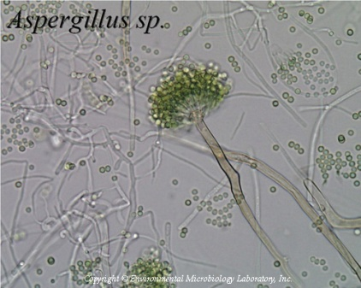
2. Ascomycetes : (Sac fungi)
Multicellular (penicillium ) / Unicellular ( yeast )
Saprophytic – decomposers – parasitic – coprophilous
Mycelium is branched and septate –asexual spores are called conidia
Sexual spores are called ascospores.
Eg. Aspergillus, Neurospora
3. Basidiomycetes : (Eg. Mushroom/ bracket fungi/ puffballs)
Grow in soil, logs, tree stumps, in plant bodies as parasitic (as rust and smuts)
Mycelium is branched and septate
Reproduction by fragmentation
Dikaryon – basidium –karyogamy
Eg. Agaricus (mushroom)

Slide 14
4. Deuteromycetes :
Imperfect fungi mycelium is septate and branched.
Only asexual reproduction by conidial spores
Saprophytes / parasitic / decomposers
Help in Mineral cycling
Eg. Trichoderma, Alternaria

Slide 15
Kingdom - Plantae
Autotrophs – size varies from herbs to tall trees. There are different groups;
Algae
Bryophytes
Pteridophytes
Gymnosperms
Angiosperms
Monocotyledons and Dicotyledons
5.Kingdom Animalia :
Heterotrophs – locomotory – holozoic / saprophytic / parasitic – cosmopolitans.
It consists of two subkingdom Invertebrata with 9 Phylum and Phylum Vertebrata (Chordata) with 5 Classes.

Slide 16
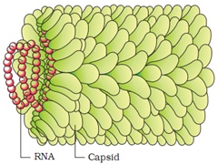
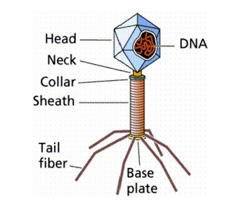
Virus:
Pasteur coined the term virus, which means Venom / poison. It is made of a outer protein coat and a centre genetic material (RNA / DNA). A virus is a nucleoprotein and the genetic material is infectious.
Virus that infect plants have single stand RNA and those infect animals have either single or double RNA or double stranded DNA. Bacteriophages are viruses that infect the bacteria. Viruses cause disease like mumps, small pox, herpes, influenza and AIDS. In plants the symptoms can be mosaic formation, leaf rolling, and curling, yellowing, dwarfing and stunted growth.

Slide 17
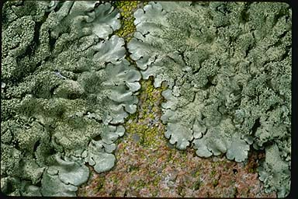
Viroids
T.O. Diener discovered a new infectious agent that was smaller than viruses and caused potato spindle tuber disease. It has only a free RNA and lacked the protein coat, so named as viroid.
Lichens
Symbiotic association between algae and fungi. Phycobiont is algal component, which prepare food for
fungi and Mycobiont is a fungal component, which provide shelter and absorb mineral nutrients and water for its partner.

Slide 18
THANK YOU

